Slide 1
Economies of Scale and Scope
Module 3 · Video 7
Management 405
Prof. Nico Voigtländer · UCLA Anderson

Slide 2
Module 3 · Agenda
Outline of Module 3
1
Introduction to Module 3
Video 1
2
The Production Function
Video 2
3
Short Run: Hiring Decisions
Video 3
4
Wage Searchers
Video 4
5
Long Run: The Optimal Input Mix
Video 5
6
Cost Concepts
Video 6
7
Economies of Scale and Scope
When bigger or broader production lowers cost per unit
Video 7
Management 405 · Module 3 · Production and Costs
2
Notes:
A quick transition. We have covered the cost concepts, fixed, variable, marginal, and average. Now we look at what happens in the long run, when the plant size itself can change. Three ideas are coming up. How long-run and short-run cost curves relate, how the long-run average cost curve is built as an envelope, and economies of scale.

Slide 3
Module 3 · Economies of Scale and Scope
Short-Run vs. Long-Run Costs
Short Run
Long Run
Capital (K) is fixed
Plant size may be too large / too small
Labor (L) is flexible
→ Adjust Q by hiring / firing labor
Both K and L flexible
Choose plant size from scratch
Pick optimal input mix for any (anticipated) Q
→ Change K and L to produce Q at lowest-possible cost
Long-run provides more freedom to optimize ⇒ typically lower average costs
Management 405 · Module 3 · Production and Costs
3
Notes:
Let's compare the short run and the long run side by side, because they lead to different cost outcomes. In the short run your capital is fixed. You are stuck with the plant you have, which might be too big or too small for the output you actually need, and the only way to change output is to hire or let go of workers. In the long run everything is flexible. You get to choose the plant size from scratch and pick the best mix of capital and labor for whatever output you expect. More freedom can only help. So long-run cost is never higher than short-run cost at the same output, and usually it is lower, because the long run lets you build exactly the right-sized plant.

Slide 4
Module 3 · Economies of Scale and Scope
Long-Run Average Cost Is the Lower Envelope of Short-Run Curves
$ / unit
SAC
(small plant)
SAC
(medium plant)
SAC
(large plant)
approximate LAC
LAC = lower envelope
Q (output)
LAC is the lower envelope of all SAC curves: pick the best plant for each Q
Management 405 · Module 3 · Production and Costs
4
Notes:
Here is how the long-run cost curve is actually built, and it is a nice picture. Each possible plant size has its own short-run average cost curve, the U-shaped ones. A small plant is cheapest at low output, a medium plant at medium output, and a large plant at high output. Now, in the long run you get to pick the plant size for whatever output you want. So for each level of output, you choose the plant that produces it most cheaply. If you trace the lowest cost available at every output, you sweep out the curve along the bottom, and that lower envelope is the long-run average cost curve. In this drawing the envelope slopes downward, which means bigger scale brings a lower cost per unit. That is economies of scale, and it is exactly what we turn to next.

Slide 5
Module 3 · Economies of Scale and Scope
Economies of Scale: Three Possible Patterns
What happens to long-run average cost (LAC) as output grows?
Economies of Scale
Constant Returns
Diseconomies of Scale
LAC
LAC
LAC
bigger ⇒ cheaper per unit
scale doesn’t matter
too big to manage
e.g. utilities · chip fabs
e.g. identical outlets
e.g. sprawling firms
Management 405 · Module 3 · Production and Costs
5
Notes:
So the key question for the long run is this. What happens to average cost as a firm gets bigger? There are three possible answers, shown here as three little cost curves. On the left, average cost falls as output grows. That is economies of scale, bigger means cheaper per unit, and you see it in things like utilities and chip-fabrication plants, where huge fixed costs get spread very wide. In the middle, average cost is flat. Size does not matter, which fits a chain of identical outlets, where the hundredth store costs about the same to run as the first. On the right, average cost rises. That is diseconomies of scale, where a firm gets too big and complex to manage well. Many real businesses pass through all three as they grow.

Slide 6
Module 3 · Economies of Scale and Scope
Technological Reasons for Economies of Scale
Specialization and division of labor
E.g., Ford assembly line vs. one craftsman building the whole car
Lumpiness / indivisibilities of inputs
R&D, network infrastructure, brand investment
Same fixed asset serves more customers as scale grows
Appropriate technology shifts with scale
Big firms can run dedicated lines, automation, AI/data infrastructure
Management 405 · Module 3 · Production and Costs
6
Notes:
Why does bigger often mean cheaper? There are a few classic reasons, and they are all on the technology side. First, specialization and the division of labor. On Ford's assembly line each worker masters one narrow task, which is far more productive than one craftsman building a whole car. Second, lumpiness, or indivisibility. You cannot build half a research lab or half a network. The fixed cost is the same whether you serve one million customers or a hundred million, so the cost per customer falls as you grow. Third, and this one is elegant, geometry. For a cargo ship, an aircraft fuselage, or a pipeline, the useful volume grows faster than the surface area you have to build and pay for. So doubling the material more than doubles the capacity. Put those together and larger scale keeps pushing the cost per unit down.

Slide 7
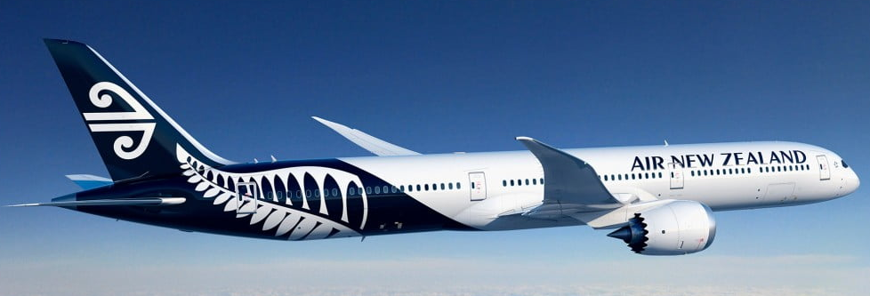
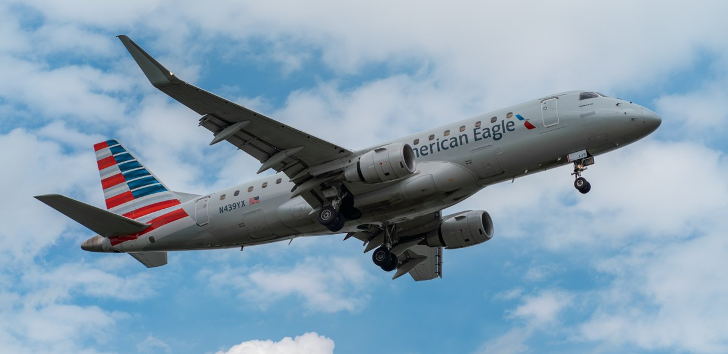
Module 3 · Economies of Scale and Scope
Economies of Scale in Aviation: E175 vs. 787
Embraer E175 · Regional Jet
Boeing 787-9 · Wide-Body
List price: ~ $50 M
List price: ~ $290 M
Seats: 76 passengers
Seats: ~ 290 passengers
Avg. stage length: ~ 500 mi
Avg. stage length: ~ 6,500 mi
Cost per Available Seat-Mile (CASM): ≈ 15¢
Cost per Available Seat-Mile (CASM): ≈ 9¢
Bigger plane → ~40% lower cost per seat-mile
Management 405 · Module 3 · Production and Costs
7
Notes:
Here is economies of scale in one clean comparison, from aviation. On the left is the Embraer E175, a regional jet. It lists for about 50 million dollars and carries 76 passengers. On the right is the Boeing 787-9, a wide-body, at about 290 million dollars and around 290 passengers. Now the number that matters to an airline is the cost per available seat-mile, how much it costs to fly one seat one mile. The regional jet comes in around 15 cents, while the big wide-body is down near 9 cents. That is roughly 40 percent cheaper per seat-mile on the larger plane. Why? Most of the costs, the fuel, the two pilots, the landing fees, scale with the airframe, not with the number of seats. Spread those costs across nearly 300 seats instead of 76, and the cost per seat-mile drops. It is the same square-cube geometry we just saw, now flying.

Slide 8
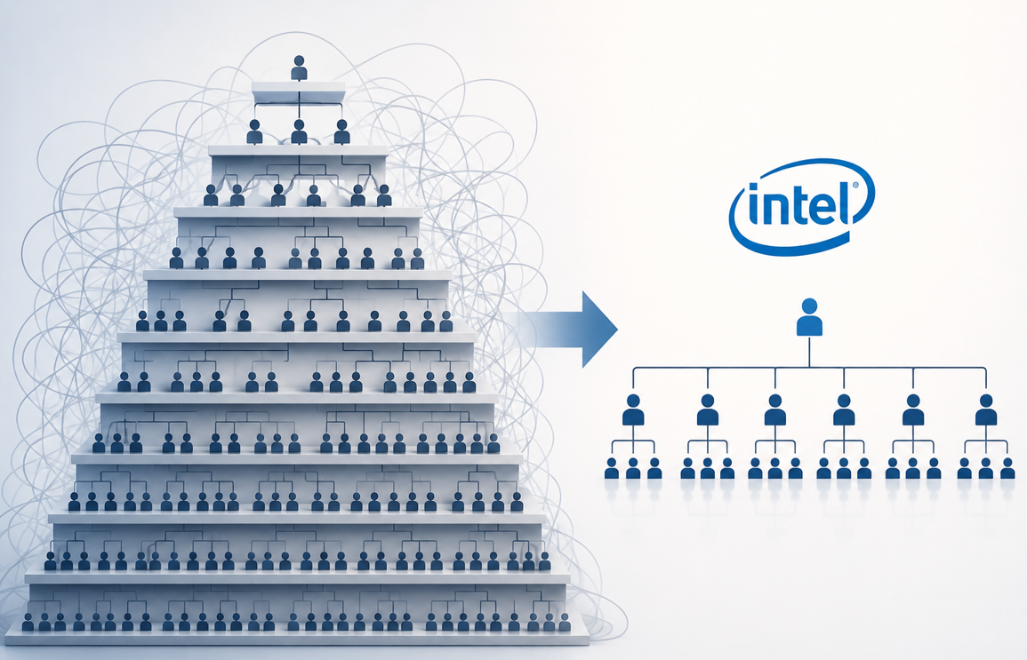
Module 3 · Economies of Scale and Scope
Reasons for Diseconomies of Scale
Coordination, communication, control get harder
More layers of management → complexity
Information has to travel up and down a longer chain
Monitoring a bigger workforce is disproportionately costly
Misaligned incentives, free-riding, principal-agent problems
Bureaucracy and staff functions grow disproportionately
HR, accounting, legal, compliance hire to support scale
Example: Intel, 2025
Many teams ran 8 or more layers deep. The CEO called this “unnecessary bureaucracy that slows us down” and ordered layers removed, spans of control widened.
Management 405 · Module 3 · Production and Costs
8
Notes:
Of course bigger is not always better, and this slide is the other side of the coin. As a firm grows, coordination, communication, and control all get harder, and they get harder faster than the firm grows. You add layers of management, so information has to travel up and down a longer chain before anything happens. Monitoring a team of 50 is one thing. Monitoring 5,000 is a completely different problem, with more room for misaligned incentives and free-riding. And the support functions, HR, accounting, legal, and compliance, tend to balloon faster than headcount.
Intel is the case on the right. In April 2025 its new CEO, Lip-Bu Tan, sent a memo to all Intel employees titled “Our Path Forward”. In it he wrote that as Intel refocused on engineering it would also remove organizational complexity, because many teams were 8 or more layers deep, and that this creates unnecessary bureaucracy that slows the company down. He asked his executive team to take a fresh look at their organizations, with a focus on removing layers, increasing spans of control, and empowering top performers. His reason was one sentence. Our competitors are lean, fast and agile, and that is what we must become to improve our execution.
Look at the picture with me. On the left is the tall organization, layer upon layer of people, with the wiring between them tangled into knots. On the right is the flat one, where the top is 2 steps away from the people doing the work. Nothing about the chip-making technology changed between those 2 pictures. What changed is the cost of running the organization around it.
There is one more thing about this example. A few slides ago the semiconductor fab was our illustration of economies of scale, because the enormous fixed cost of a fabrication plant gets spread over more and more wafers. Intel has those scale economies in the fab and these diseconomies in the org chart at the same time. Both forces act on the same firm, and the shape of the long-run average cost curve is the net of the two. At some point the frictions outweigh the savings, and average cost turns back up.

Slide 9
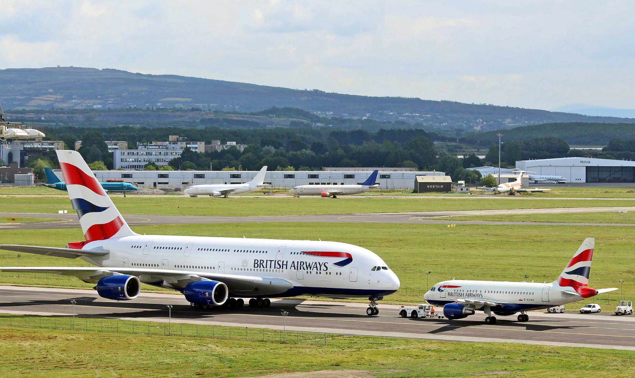
Module 3 · Economies of Scale and Scope
Economies of Scope
Economies of scope: producing 2+ related products together is cheaper than separately
Shared input production
Shared engineering know-how & R&D
Shared brand, sales channel, marketing
Shared supply chain & customer data
Example: Airbus's A380 and A318 share engineering, supply chain, brand
British Airways A380 + A318 (CC BY-SA, Wikimedia)
Scope ≠ scale: one firm, MANY products → cheaper than splitting them up
Management 405 · Module 3 · Production and Costs
9
Notes:
Economies of scale is about making more of one thing. Economies of scope is its cousin, and it is about making a broader range of things. The idea is that producing two or more related products together can be cheaper than producing them separately, because they share expensive capabilities. Think of shared engineering know-how, a shared brand and sales channel, a shared supply chain, and shared customer data. Airbus is a good example. It designed the giant A380 and the small A318 with shared engineering, common cockpit elements, and the same supplier base, so building both is cheaper than if two separate firms built each alone. Apple does the same across the iPhone, iPad, and Mac, sharing its chips and its operating system. Scope is about breadth, scale is about depth, and the strongest firms exploit both.

